Slide 1
Building Better Bricks: Module design and development best practices.

Slide 2
Chris Gardner
DevOps and ALM consultant at Black Marble
4+ Years PowerShell experience
Spent the last year+ automating software builds and writing DSC
Contribute to various DSC resources and maintain 1.5 of my own
Usually found on Slack (PSUGUK and PowerShell)
https://www.github.com/ChrisLGardner

Slide 3
Agenda
Why?
Module Structure options
Function Design
Build Scripts

Slide 4
Why?
We’re developers
Easier for other people to contribute
Easier for people to use
Notes:
https://github.com/PoshCode/PowerShellPracticeAndStyle
A dev in my opinion is anyone who has written and saved a PowerShell script. Copy/Pasting from Google or StackOverflow doesn’t quite count. That doesn’t mean everyone is suddenly a good developer. You can be a developer no matter what your actual job title is.
To be a good developer you need to implement more of the practices that “traditional” developers use, like source control, unit testing, CI, etc. Not all developers do this, I’ve got a number of horror stories about people who claim to be developers not doing some of these things (or all of them in the case of one team) but just because your job title is developer doesn’t mean you’re a good developer. The reverse is also true, just because your title is sysadmin doesn’t mean you aren’t a good developer.

Slide 5
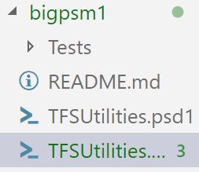
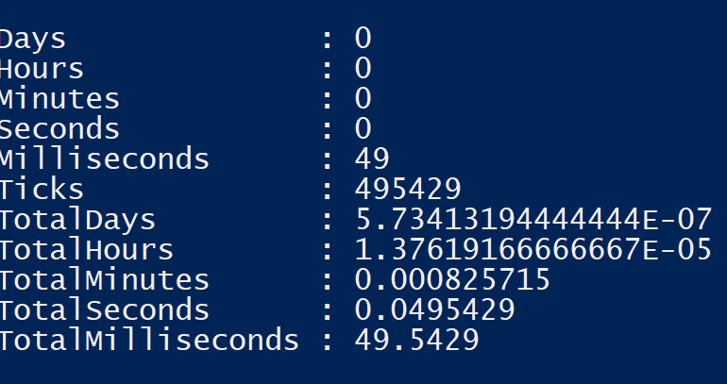
Module Structure – Big psm1
Pros
Quick to load
Easy to distribute
Cons
Difficult to maintain
Can become very long
Notes:
In the example module there are 3700+ lines of code in the psm1. Trying to resolve merge conflicts on that size file gets pretty difficult and just generally reviewing the changes on such a file isn’t easy.

Slide 6
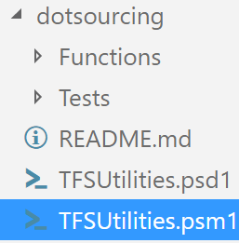
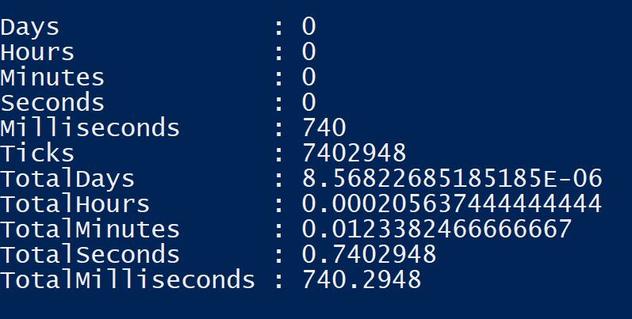
Module Structure – Dot sourced ps1
Pros
Easy to maintain
Short PSM1
Easy to add more functions
Cons
Slow to load
Potential security issues
Slow command discovery
Notes:
When doing code signing you have to sign every single file in the module, the numbers shown here don’t include that but get considerably worse when you have to check the signing on every single file.

Slide 7
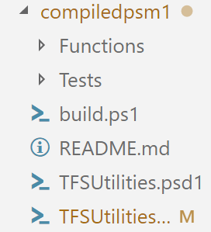
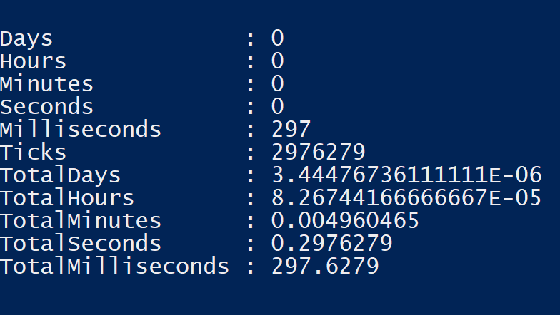
Module Structure – Compiled psm1
Pros
Easy to maintain
Quick to load
Easy to distribute
Easy to add more functions
Cons
Extra learning required to use
Automation needed
Notes:
You should only ship the pd1 and psm1.

Slide 8
Function Design
Always include an output type for functions which output an object
Always write-output/$var your objects
Always include a PSTypeName for custom objects
Accept pipeline input on Set-*/Update-*/etc functions
Notes:
https://stackoverflow.com/a/66693/7612001
https://poshoholic.com/2008/07/05/essential-powershell-define-default-properties-for-custom-objects/
https://poshoholic.com/2008/07/03/essential-powershell-name-your-custom-object-types/

Slide 9
Build Scripts
Invoke-Build and PSake for pure PS build automation
VSTS, AppVeyor, Gitlab etc
Three key steps needed:
Build psm1 from all your ps1 files
Test your built psm1
ScriptAnalyser your psm1
Notes:
The crucial thing here is that you should be testing/PSSA’ing the compiled PSM1. If you don’t then you’re not testing the same thing that you’re shipping.
Automating all of this with InvokeBuild or PSake is a great step too, we’re writing PowerShell to automate the boring things, why wouldn’t we then use PowerShell to automate the building of that automation.
Platforms like VSTS etc are usually free or cheap (depending on users and where your code sits), they make it much easier to implement this sort of build automation and store your code. The larger tools like VSTS and Gitlab come with even more tools, VSTS in particular also comes with work item management that can be leveraged to let you track the next few features you want to add in your code, or any bugs that have been found. Both platforms give you a range of tracability options too, you can get pretty build output to see how your tests ran and fail builds if the tests fail.

Slide 10
Questions?

Slide 11


Chris Gardner
@halbaradkenafin
Chrislgardner.github.io
github.com/chrislgardner
Contact Details

